Slide 1
COMPUTER DATA SECURITY Fall 2017
Dr. Eduardo B. Fernandez
Dept. of Computer Science and Eng.
Florida Atlantic University
http://faculty.eng.fau.edu/fernande/
ed@cse.fau.edu
Notes:
Dr. Fernandez is a Professor of Computer Science and Engineering at Florida Atlantic University, Boca Raton, FL.
He has a MSEE from Purdue University and a Ph.D. in Computer Science from UCLA.
He is the author of one of the first books published on database security and has written numerous papers on different aspects of security. He has also published a good number of papers on object-oriented design and fault-tolerant systems.
He has been a consultant for many companies, including IBM, Siemens, Harris, Motorola, and others.

Slide 2
The value of information
We depend heavily on computers; most of the devices that make our life safe and convenient, e.g. cell phones, vehicle controls, and building controls, use some type of software
We also rely on institutions, public or private; we are born in hospitals, then go to schools, join clubs, get jobs in the government or private businesses, get married at some church or public office, travel using some agency, etc. All these institutions use computerized information, a good part of which is about us.
In general, the data of an institution has great value; it may represent customers, orders, bills, business plans, course grades, etc.
For example, data corruption in a hospital may result in patients getting the wrong medication, leakage of military information could endanger an army in war, and erroneous aircraft maintenance information could compromise passenger safety.

Slide 3
Motivation for security
Data and other resources are assets, items that have value for us; security is the protection of these assets, including enterprise and individual information.
We need this protection because there are people who intentionally try to access or modify information either for their own gain, for political purposes, or for the sake of disruption
In addition to the direct monetary cost there may be losses of productivity, and even endangering of lives

Slide 4
Do we have a problem?
Almost every week we have a major security incident.
Companies: Target, Sony (twice), Home Depot, Goodwill, JP Morgan, Chick-fil-A, Neiman Marcus, Yahoo,…
Government: IRS, DOE, OPM, US presidential campaign…
Physical systems: Stuxnet (Iran), German steel mill, Aramco,…
Medical systems: several, e.g. Anthem
Point of sale: Target, Michaels, Home Depot, …

Slide 5
Attacks to medical devices http://www.healthcareinfosecurity.com/medical-device-hacks-dangers-a-7464/op-1
It's only a matter of time before a patient is killed or injured due to a targeted cyber-attack against a medical device - or even as the result of an unintentional cyber vulnerability. A warning from experts participating in a medical device cybersecurity workshop hosted by the Food and Drug Administration on Oct. 21, 2016.
Remotely tampering with a Web-enabled implanted medical device, such as a pacemaker, has the potential to be as deadly as using a gun in an assassination attempt, says Jason Lay, manager of cyberthreat information at the U.S. Department of Health and Human Services. "We know this possibility is very real.“
In addition to potential premeditated murder scenarios, patients could be harmed in other circumstances, such as a cybersecurity attack by a nation state on an unprotected medical device that's used as an entry point to steal an academic medical center's intellectual property.

Slide 6
Misinformation state attacks 2016-17
Russia and the US Elections
United Arab Emirates against Quatar--UAE planted false declarations of the Quatari ruler praising Iran and Israel
India accused Pakistan of inciting violence
Vietnam and Philipines

Slide 7
Attack to German steel mill http://www.theregister.co.uk/2014/12/22/hackers_pop_german_steel_mill_wreck_furnace/
Hackers have caused "serious damage" after breaching a German steel mill and wrecking one of its blast furnaces.
The hack of the unnamed mill was pulled off after a victim fell for a phishing email.
Hackers then pivoted to the production network, a feat that should not be possible according to best practice that requires separation between industrial control systems and the public internet.
"The result was that a blast furnace could be shut down“
"The attackers were knowledgeable in conventional IT security and had extensive knowledge of applied control and production processes.“
The attacks likely demonstrated the mill had not employed sufficient separation of internet-facing and critical production networks.

Slide 8
Almost every week we have a serious breach: attack du jour
Identity thieves hijack cellphone accounts to get digital currency
https://www.nytimes.com/2017/08/21/business/dealbook/phone-hack-bitcoin-virtual-currency.html?rref=collection%2Fsectioncollection%2Ftechnology&action=click&contentCollection=technology&region=rank&module=package&version=highlights&contentPlacement=1&pgtype=sectionfront&_r=0
http://www.macworld.com/article/3082626/security/your-cell-phone-number-could-be-hijacked-unless-you-add-a-pin-to-your-carrier-account.html

Slide 9
Costs of a data breach
An attack on Google cost that company about $500,000 in 2005.
Cost of Data Breach Study: Done by Ponemon Institute, sponsored by IBM, June 2017
According to them, the average total cost of data breach for the 419 companies participating in this research decreased from $4 to $3.62 million. The average cost for each lost or stolen record containing sensitive and confidential information significantly decreased from $158 in 2016 to $141 in this year’s study.
However, despite the decline in the overall cost, companies in this year’s study are having larger breaches. The average size of the data breaches in this research increased 1.8 percent

Slide 10
Careers in security
U.S. News and World Report ranked a career in information security seventh on its list of the 10 best technology jobs for 2017. The Bureau of Labor Statistics expects this profession to grow at a rate of 18 percent through 2024. The median annual salary for these positions is $90,000, with jobs in the 75th percentile in tech hubs, including San Francisco and New York City, paying between $115,000 and $140,000 or more.
The Cisco 2014 Annual Security Report warned that the worldwide shortage of cybersecurity professionals was at 1 million openings. Cybersecurity Ventures predicts there will be 3.5 million unfilled cybersecurity jobs globally by 2021 (and a zero-percent unemployment rate)—driven by cyber attacks and data breaches, which are growing in frequency and sophistication.

Slide 11
Salaries for 2016
Title | 2015 | 2016
CSO | $134,250-$204,750 | $140,250-$222,500
Data Security Analyst | $106,250-$149,000 | $113,500-$160,000
Systems Security Administrator | $100,000-$14,0250 | $105,500-$149,500
Network Security Administrator | $99,250-$138,500 | $103,250-$147,000
Network Security Engineer | $105,000-$141,500 | $110,250-$152,750
Information Systems Security Manager | $122,250-$171,250 | $129,750-$182,000

Slide 12
The Nature of Software...
Software is intangible
Hard to understand development effort
Software is easy to reproduce
Cost is in its development
in other engineering products, manufacturing is the costly stage
The industry is labor-intensive
Hard to automate

Slide 13
The Nature of Software ...
Untrained people can hack something together
There are many kits to build apps with little knowledge
One-week coding courses are common
Quality problems are hard to notice
Software is easy to modify
People make changes without fully understanding them
Software does not ‘wear out’
It deteriorates (erodes) by having its design changed:
erroneously, or
in ways that were not anticipated, thus making it more complex or less secure

Slide 14
The Nature of Software
Conclusions
Much software has poor design and is getting worse
Demand for software is high and rising
Software complexity is increasing
We are in a perpetual ‘software crisis’
We have to learn to ‘engineer’ software
An important aspect to engineer is security

Slide 15
Software complexity
Embedded systems
The average device now has one million lines of code, and that number is doubling every two years.
Aerospace
A modern passenger jet, such as a Boeing 777, uses about 4 million lines of code. Older planes such as a Boeing 747 had only 400,000 lines of code.
A car uses 30-50 electronic control units (ECUs) that altogether include as much as 100 M lines of code.

Slide 16
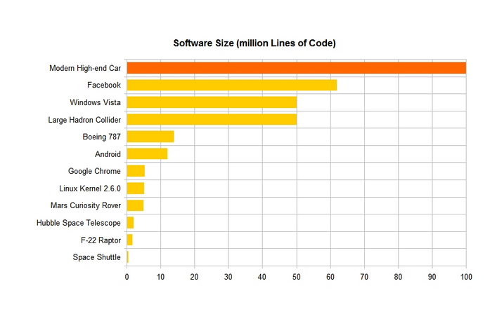
Code size https://www.linkedin.com/pulse/20140626152045-3625632-car-software-100m-lines-of-code-and-counting

Slide 17
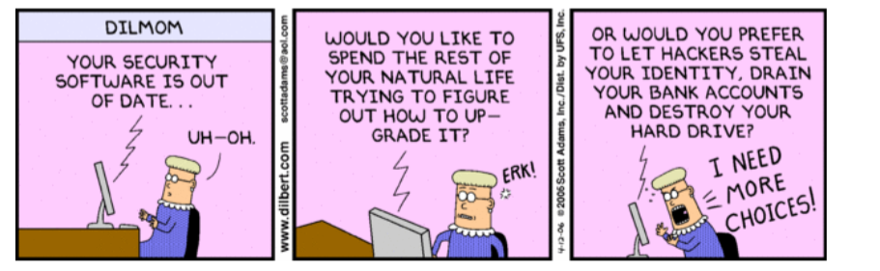

Slide 18
About this course
Its objective is to provide a conceptual overview, how attacks and defenses relate to the system architecture (holistic view)
The Internet is complex, is evolving rapidly, and global understanding is fundamental for security
Emphasis on important new developments: web services, clouds, wireless systems, standards, patterns
An engineering, not theoretical, approach.
Use of patterns and UML to provide precision

Slide 19
Is this Cybersecurity?
A new name for old concepts, but yes, it is.
The idea is to make security more holistic, not focusing on specific mechanisms
Architecture-oriented or model-oriented security
This course has had that orientation for a long time

Slide 20
Critical security thinking
Analysis to understand the complete picture, look at a combination of specific components—architectural view—and see the resultant effect on security
Synthesis: what should we add or change in a system to get a given degree of security; how to build secure systems.
No blind application of rules
Design-oriented problems do not have algorithms or unique solutions
Decisions are based on experience and knowledge

Slide 21
Another (similar) opinion
The mantra of any good security engineer is: “Security is not a product, but a process.
It's more than designing strong cryptography into a system; it's designing the entire
system such that all security measures, including cryptography, work together. “
– Bruce Schneier

Slide 22
Becoming a security expert Michael Howard, Security Program Mgr., Microsoft
IEEE Sec. & Privacy, Jan/Feb 2007
Few people understand how to build secure systems
You should understand threats
Defenders must defend all points; attackers can probe for unknown vulnerabilities and choose the weakest ones
Look first for design vulnerabilities and build defenses in the design
Apply design principles
Never trust input

Slide 23
Can we measure security?
There is no absolute or quantitative measure of security, we can just find qualitative measures.
If we can enumerate threats systematically and we can show that all are stopped or mitigated, we consider a system secure. That is our measure of security.
We can never say that a system is 100% secure but we can make the work factor for the attacker very high.
The attack surface measures the points and ways to attack a system; we can reduce it considerably.

Slide 24
About me
Eduardo B. Fernandez (Eduardo Fernandez Buglioni)
Professor of Computer Science at Florida Atlantic University, Boca Raton, FL., USA
Worked at IBM for 8 years (L.A. Scientific Center).
Wrote the first book on database security (Addison-Wesley, 1981) and two books on security patterns (2006 and 2013)
Author of many research papers, (Google Scholar h-index 35, i10index 110)
Consultant to IBM, Siemens, Lucent, Huawei,…

Slide 25
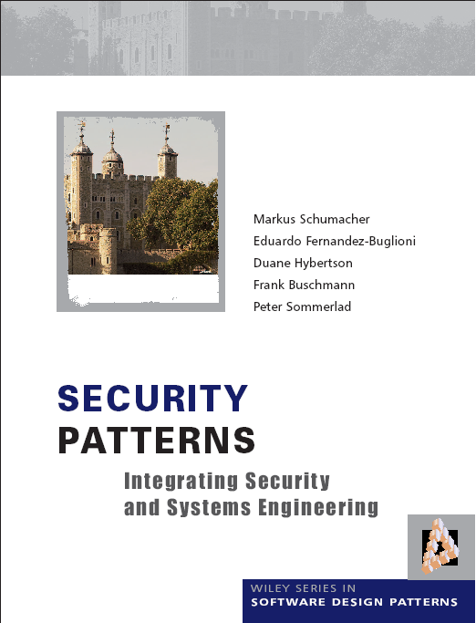

Slide 27
Course details I
Prerequisite: general background on operating systems, architecture, and languages. Some UML
Content: Overview of technical aspects of data security with emphasis on the Internet and distributed systems. Attacks and defenses. The design of secure systems. Use of security patterns.
Textbooks: E.B.Fernandez, The Design of Secure Systems (class notes)
Slides, papers, and notes in Canvas.
Reference: W. Stallings and L. Brown, Computer security: Principles and practice (3rd. Ed.), Prentice Hall 2015.

Slide 28
Course details II
E-mail: fernande@fau.edu
Web page: http://faculty.eng.fau.edu/fernande/
Office Telephone: 561 297 3466 (only for emergencies)
Goals: Analysis of security problems in the combination of the Internet with Intranets. Need to protect all architectural levels. Understanding of how to coordinate hardware and software to provide protection against internal and external attacks.
Grading: Take-home Assignments (3) 45%
Take-home Final Exam 55%

Slide 29
Assignment 1 (old)
1) Is a high level of Internet anonymity a good thing? Discuss its advantages and disadvantages.
2) A computer system doesn’t perform authentication. However, it performs Authorization (assume it works properly). What kinds of general security attacks are possible here? Consider also the effect of having or not having logging. By general, we mean not tied to some implementation.
3) Draw a sequence diagram to describe the recent Sony attacks. Find information in the Internet and indicate your sources (references).

Slide 30
Old Assignment 2
If we add layers to a microkernel we can assign servers to different layers. Indicate:
The advantages of this approach
The disadvantages of the approach
Modify the class diagram of the microkernel to include the
concept of layers.
2. Indicate the advantages and disadvantages of using public key certificates. Find three commercial systems where certificates are used to perform authentication. Give References.
3. The diagram of the Virtual Vault in slide 119 of Chapter 4 shows 4 partitions: Inside, Outside, System, and System Hi. Use a multilevel access control model for secrecy (Chapter 2) to protect the components shown in the diagram. For example, an attacker should not be able to deface the web pages or overwrite the audit trail. (Assume that the Outside partition can be compromised and prevent the attacker to harm the other partitions).

Slide 31
Objectives
Understanding of the security problems introduced in the combination of the Internet with Intranets, mobile devices, and sensors.
Understanding of how all aspects of a computer system contribute to security.
Providing a perspective on how a variety of mechanisms should work together to defend a system
Developing ability to evaluate and compare diverse systems or mechanisms with respect to their security.
Basic understanding of the theoretical and conceptual aspects that are needed to build secure systems
Critical discussion of socio-technical aspects of security

Slide 32
Approaches to security
Formal Models and cryptography
Theoretical
Analysis of
Security
Verification
UML/OCL models
Security patterns
Certification
Model-driven
Security
Vulnerability analysis
Code examination
Code-based
Security
Certification

Slide 33
Approaches to security
Theoretical models using model checking do not prove security because they make many assumptions which may not be true in practice. Limited in size.
Cryptographic methods are effective but only for specific aspects: system or message authentication, secure transmission of messages, storage protection. They cannot stop attacks based on code or system flaws.
Code-based methods cannot find all vulnerabilities and many attacks exploit system interactions, not code flaws.
Model-based security builds a strong structure where parts of the system may be compromised but the essential parts of the system can be protected.

Slide 34
Need for a holistic view
Need for a holistic view, not disjoint pieces. Disjoint mechanisms cannot prevent threat that are combinations of legal actions
Security should be based on institution policies
Methods based on local system protection, e.g., cryptography , are very important to enforce the high-level restrictions but are not enough to provide systems security.
Code-based security is incomplete, security is a systems problem
Notes:
Without institution policies security is hopeless. In that case security will become a series of patches and isolated measures with enormous holes in between.
This is the case of many places now.

Slide 35
Outline
1. Introduction: Motivation and definitions. Internet and Intranet-- Structure, growth, possibilities. Environment for security. Effect of new technologies. Related subjects. The Internet and its threats. Vulnerabilities and threats: Viruses, worms, denial of service, attackers.
2. Security policies and models: Institution, legislation, and privacy policies. Compliance. Forensic policies. Security models: Access matrix, multilevel, mandatory, discretionary models. Role-Based Access Control. Patterns for models.

Slide 36
Outline II
4. Security in hardware and operating systems: Effect of hardware on security. Process and memory protection (modes, rings). Virtualization. Vulnerabilities. Unix, Linux,Windows. Hardened operating systems. Authentication.
5. Program and application security: Malicious software: Trojan horses, Viruses, and worms, the buffer overflow problem. Security in languages and components.
6. Database security: Using views for authorization in relational databases. Authorization systems in Oracle and similar systems. SQL injection and other attacks. NoSQL databases. Data intensive systems security.

Slide 37
Outline III
7. Network Security: Attacks. Secure layers. SSL, Kerberos, VPNs, Firewalls. Intrusion Detection. Wireless systems, smart phones and tablets.
8. Distributed systems: Web security, Cross-scripting attacks. Security in Web Services and in cloud computing.
The Internet of Things.
9. Developing secure software and systems: Secure system design methodology. Use of patterns. Formal methods, model checking. Code-based secure lifecycles.
Evaluation of security.

Slide 38
Secure Systems Research Group
We meet once a week to present our work or to hear visitors.
In EE405 on Thursdays at noon, unless otherwise indicated.
If interested send me your name to put you in our mailing list.
We produce theses and write papers

Slide 39
Travel during the semester
Because of my research activities I must travel
A professor who does not do research or consulting cannot be effective to teach modern technologies which change constantly, especially graduate courses
To be missed: One class in September, one class in October, and two classes in November
My PhD students Madiha Haider and Virginia Romero will replace me during the times I travel

Slide 40
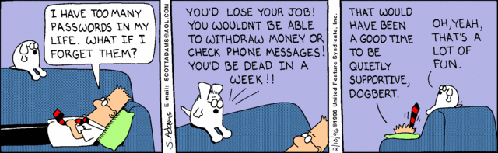

Slide 41
Value of information
We rely on information for our credit, health, professional work, business, education,…
Data is valuable for individuals and institutions
This value attracts criminals, terrorists, and vandals
Unauthorized access (reading, modification, or destruction) to information can produce all kinds of serious problems

Slide 42
The security problem
Unauthorized data disclosure (confidentiality or secrecy).
Unauthorized data modification (integrity). May result in inconsistencies or erroneous data. Data destruction may bring all kinds of losses.
Denial of service—Users or other systems may prevent the legitimate users from using their system. Denial of service is an attack on the availability of the system.
Lack of accountability—Users should be responsible for their actions and should not be able to deny what they have done (non-repudiation).

Slide 43
The meaning of security
Security implies providing these objectives in the presence of attacks
Security requires technical, managerial, and physical countermeasures
We only consider technical aspects here
A related aspect is privacy, a legal and ethics concern

Slide 44
Attacks and defenses
The generic attacks are realized in two basic ways: by direct attacks from a person trying to exploit a vulnerability or flaw in the system, or using malware, software that contains code that exploits one or more of these flaws
Security defenses may operate in one or more of three modes and we need to combine them:
Prevent or mitigate an attack. Prevention means completely stopping the attack while mitigation implies partial defense or reducing its effects
If we cannot stop or mitigate the attack, at least we should be able to know that an attack is happening, i.e., we should detect the attack. Detection is also useful to stop an attack because it can alert other mechanisms to take action
After the attack has happened we need to have ways to recover from its effects and analyze it so we can improve the system

Slide 45
Countermeasures (defenses)
Identification and Authentication (I&A)—Identification is a user or system action where the user provides an identity. Authentication implies some proof that a user or system is the one he/she/it claims to be. The result of authentication may be a set of credentials, which later can be used to prove identity and may describe some attributes of the authenticated entity (See Chapter 3).
Authorization and Access control (A & A)—Authorization defines permitted access to resources depending on the accessor (user, executing process), the resource being accessed, and the intended use of the resource. Access control enforces the permitted accesses (See Chapter 2).

Slide 46
Countermeasures II
Logging and Auditing (L&A)—Implies keeping a log of actions that may be relevant for security. These functions can be used to collect evidence for prosecution (forensics) and to improve the system by analyzing why the attack succeeded.
Hiding of information—It is usually performed by the use of cryptography but steganography is another option.The idea is to hide the information in order to protect it ( Chapter 3).
Intrusion detection—Intrusion Detection Systems (IDS) alert the system when an intruder is trying to attack the system (Chapter 7). Alternatively, they detect if an attack has happened (antivirus). Enhanced by big data and analytics. May include deception.

Slide 47
Basic security architecture
Authentication must happen first
Authorization rules define what is allowed or not allowed (who can see what and how)
Lower architectural levels enforce authentication and authorization (assurance)
Cryptography protects communications, stored data, and provides non-repudiation and authentication
Logging for future auditing
You have to know where to apply these mechanisms
Too much is expensive and slow; too little is insecure

Slide 48
Related aspects
Assurance is a measure of the trust we put on a system as being able to provide the required degree of security
Risk analysis is the study of possible attacks and their impact in terms of money and time. We need it to perform some risk analysis in order to decide on the investment on systems and personnel to provide security. We need to enumerate the threats to the system to know how much effort and money we should invest to make the system secure
Governance refers to the responsibilities of the institution directors to define policies and regulations to handle their information. Typically, directors focus on increasing the value of their assets but don’t pay much attention to their security. According to statistics, more than 50% of the businesses in the world spend 5% or less in their security budget.

Slide 49
More Related topics
Reliability and fault tolerance—Controlling the effect of accidental errors
Dependability—confidence that the system will follow its specifications
Survivability—ability to provide service in the presence of disruptions
Privacy—an individual right, not a technical issue, although its protection is usually done by technical means

Slide 50
Socio-technical issues
Ethical aspects
Balancing security with privacy
The threat of data mining
Is open-source code more secure?
Should we hire hackers?
Cyberwar threats

Slide 51
Some causes for the security problem
No use of good software development methodologies, e.g. no object-oriented programming. Emphasis on fast methods. Bad quality code.
Lack of modularity. Systems that cannot be decomposed as a marketing strategy. These systems lack well-defined interfaces.
No use of secure system design principles. The approach to develop secure code in many places is to look for specific vulnerabilities in the code, a very difficult task.
Correction by patching. When a vulnerability is detected, the vendor issues a patch to stop it. This has the side effects of disturbing the execution of current applications and possibly creating new vulnerabilities.
Unnecessary complexity. Systems are built with more functions that are needed for most applications. Bloatware.
Outsourcing. To reduce costs many companies outsource code development and maintenance to other companies, usually in countries with lower salaries.
No sanctions against companies that expose customers’ data
Myths and misconceptions about security.

Slide 52
Bloatware P. McDaniel, Computingnow.computer.org
Smart phones come now with over 60 apps., which cannot be deleted (bloatware)
These applications affect the system negatively even if not used
Some applications constantly poll or update data running background processes
Privacy effect: spyware, track user location
Security effect: more code to attack
The practice is not new, Windows uses this approach
Application developers pay the phone companies to put their apps in the phones
Lenovo is putting this software in the PC microcode (firmware)

Slide 53
Some misconceptions
It is the user’s fault
It is the security administrator’s fault
Attackers are all outside
Cryptography and firewalls are enough
Patches for your system will solve the problem
See Oppliger, IEEE Computer June 2012.

Slide 54
Distributed systems
A distributed system contains autonomous computational units that interact (interoperate) with each other through messages and are connected through some type of network.
Why are distributed systems important? Most practical information and control systems are distributed systems. Examples: the Internet, intranets in companies, wireless networks, aircraft control systems, distributed databases, and distributed file servers

Slide 55
Architectures
The architecture of a system defines the system in terms of components (units) and of interactions between these units. Architecture includes: system topology and organization, decomposition into components, assignment of functionality to components, component interactions, system properties (nonfunctional requirements, e.g. performance, security), correspondence between requirements and units.
The architecture of a system is a basic determinant of its security; code flaws can be corrected or patched, architectural deficiencies cannot.

Slide 56
Security environments or contexts
Early systems were isolated and single user --few security problems
Mainframes brought many users but we knew them (registered)—complexity and attacks increased
Distributed systems increased the problem by scattering the users

Slide 57
Environments II
The Internet opened up our systems to unknown users—exponential growth in attacks
Wireless devices increase the problem because of their number and ubiquity
The widespread use of sensors will make security even worse

Slide 58
The web (WWW)
Universal Resource Locators (URLs) for addressing and linking
Hypertext Markup Language (HTML) for information
Hypertext Transfer Protocol (HTTP) for information transfer (client/server model)
8/28/2017
58

Slide 59
Basic Architectural components
Web browsers -- can request HTML documents, provide URL caching , support directories
Web servers -- receive user requests , find and return documents
Files or DBMS store documents
Documents -- pages or sets of pages
Notes:
The architectural structure of the web is also relatively simple:
Browsers: simple and standardized user interfaces
Servers -- Combinations of hardware and software to service requests for pages
Documents stored in files or DBMSs (Database Management Systems)-- In fact, we can see the whole corporate database as information that can be incorporated in web documents

Slide 60
Basic Internet architecture
Data
Web
browser’s
HTML
Web
servers
HTTP
users
Notes:
This is the basic functional architecture.
The web browser represents the client side.
The web server is the server side and accepts requests for pages.
The HTTP protocol is a basic protocol for transmission of pages
The pages may reside on files or in database management systems

Slide 61
Web documents
Hypertext /multimedia
Passive or active (contain links to programs)
Fixed or dynamic (assembled on request)
Potentially all institution data can be considered documents
Notes:
Documents can include links to other documents (hypertext) and different types of media (multimedia)
Passive documents are pages that include only text or images
Active documents incorporate exceuting programs and can display animation, perform calculations, etc.
Fixed pages have a predefined structure
Dynamic pages are variable and contain variable information

Slide 62
XML
XML is a metalanguage to define the meaning and structure of documents. A subset of SGML (Standard Generalized Markup Language). Basic ideas: use tags in data items to define their meaning, relate data items through nesting and references.

Slide 63
Internet impact
Used practically everywhere in the world
More than 300 million pages
Changes in information access and dissemination
New ways of institution operation
New user activities
New architectures
Notes:
Not many countries are left without access to the Internet
If you spend the rest of your life surfing the web you could not even look at all the pages
The Internet has had a profound effect on the way we use information
Enormous impact on business
New activities, not possible before and old activities performed in a better way
Different and more complex system architectures

Slide 64
Changes in information access
Larger variety of data : hypermedia documents, applets, components, relational databases, OO databases, …
New ways of accessing : direct downloading of content, remote forms filling, remote updates,...
Notes:
The way of accessing information has changed :
Documents or other types of content can be downloaded from anywhere in the web
Documents have a large variety, they come from anywhere: home PCs, corporate DBMSs, ...

Slide 65
New ways of operating
Mobile employees
Partners
Customer access to products, orders,…
Global business
Contractors
Notes:
Corporations have changed their was of doing busines. Not all of these are the result of the Internet but the Internet makes easier these ways of operating .
Employees on the road can access (read and write) corporate databases
A company may work on partnership in some business with one of its competitors.
Customers want to see the status of their orders
A company may have subsidiaries in many countries with different standards and laws
Increasing use of contractors

Slide 66
New user activities
Remote conferencing
Remote course taking
Cooperative work
Web shopping
Scheduling of activities
Synchronization of mobile users with business activities
Notes:
Some of these activities could not be done without the Internet, others can now be done better.
Remote conferencing with access to images, animation, …
Remote course taking is becoming popular : assignments posted in the web
Cooperative work: I can write papers with people in other countries
Shopping is taking flight this Christmas season

Slide 67
Hospitals on line
Insurance companies -- enroll patients on line, status of claims, benefits information
Medical labs -- laboratory results
Doctors -- advice to patients, consult with other doctors
Records on line--patients can access their records
Notes:
Health-providing institutions and insurance companies have extended their reach.
A user can access his insurance information and get enrolled in different programs online, can check staus of his claims, .benefits limits and restrictions,…
Some medical labs are putting exam results online
Patients can put their records in the Internet and if they are traveling a doctor in another country can access them in seconds.

Slide 70
Enterprise architectures

Slide 71
Components
There is no consensus in its definition. In some views, a component is a unit of independent deployment, a unit of third party composition, and has no persistent state
Other definitions add contractually specified interfaces. Others say it must have state
Require specific supporting frameworks
Examples: J2EE, .NET, CORBA

Slide 72
Web Services
A Web Service is a type of component that is available on the web and can be incorporated in applications or used as a standalone service
Require a standard supporting framework
The web is becoming a marketplace of web services

Slide 74
Architectures
Web services (eServices) are a part of the application layer
Web services are built out of XML, a lower-level data layer
A SOAP layer is used for XML message transmission
Internet layers and web server layers provide support for these layers

Slide 76
Changes I
Sensors
Sensors can be used to detect fires, flooding, burglaries, and many other events. Some use RFID devices, others are more elaborate. They introduce many useful functions but also new security problems such as repeated interrogations to provoke battery drainage. RFIDs are low-cost sensors. They are very useful to keep track of inventory and locate physical items and many companies are starting to use them. They can also be used for automatic tolls in highways and in implanted medical devices. They bring up, however, serious privacy and other security issues.
Peer-To-Peer systems (P2P)
P2P systems are based on the idea of systems without predefined roles that send or receive information from each other. They use bidirectional web services, grid computing, or similar approaches. In a P2P system all the nodes are able to find and consume, or offering and fulfilling information and processing services.

Slide 77
Changes II
Portable devices
These include cellular phones, PDAs, laptops, even iPods. They are usually wireless and in number they surpass by far the traditional computer systems. All these devices can be sources of vulnerabilities and malware specially oriented to them has started to appear. Their loss or theft provides a new source of attacks. The wireless medium in itself provides new ways to attack the systems. Because their location can be tracked there are also new privacy concerns.
Embedded systems
A computer system which is part of a larger system to which it adds some intelligence. Examples are computers in cars, cell phones, airplanes, washing machines, and voltage controllers in power transmission lines. They introduce new attacks such as attacks that disrupt system timing [Koo04].
Cyber-physical systems
A cyber-physical system (CPS) integrates computing and communication capabilities with the monitoring and control of entities in the physical world. Such control systems are normally distributed, real-time, and usually include embedded devices, sensors, and wireless links

Slide 78
Changes III
The Internet of Things (IoT)--the interconnection through the Internet of uniquely identifiable and addressable embedded devices. A thing can be a washing machine, a person with a heart monitor, a farm animal with a biochip, an automobile that has built-in sensors to alert the driver when tire pressure is low -- or any other natural or man-made object that can be assigned an IP address and provided with the ability to transfer data over a network.
Machine to Machine Communication (M2M)--technologies that allow both wireless and wired systems to communicate with other devices of the same type

Slide 79
Changes IV
Cloud computing.
Pools of virtual resources can be shared by users who pay for what they use. This is an attractive platform for small institutions with variable number of customers, which don’t need to make heavy investments to support their growth. Because the cloud is accessed through the Internet the usual security problems are present plus some new ones.
Open source software
Open-source software is making inroads in areas such as operating systems, web servers, and compilers. Their relative security is a controversial aspect, some believe they are more secure, others consider them less secure [Cow03] (See exercise 1.4).
Outsourcing of software development
Many companies send the development, maintenance, or servicing of their products to countries with lower salaries. This practice introduces or exacerbates security problems, such as the possible introduction of malware in the software

Slide 80
Environment evolution
Exclusive use devices
Shared resources with registered users—mainframes
Distributed resources, registered users—PCs connected to servers
Distributed resources, unknown users
Several devices per user—smart phones
Pervasive devices—sensors, IoT

Slide 81
Threats
Definitions
Types of misuse
Internet vulnerabilities
Attacks

Slide 82
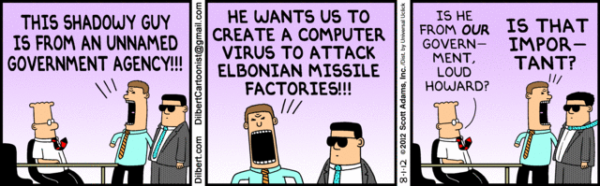

Slide 83
Securing systems
We need to understand the threats to the system to decide how to defend it
Excess of security mechanisms results in loss of performance, extra complexity, and higher costs
The objective is to provide an appropriate defense according to the value of our assets

Slide 84
Types of Threats
Direct attacks to the operating system
Direct attacks to the database system
Directs attacks to the application
Denial of service
Almost no attacks to the messages in the network
Malware: Trojan horses, viruses, worms
Repudiation

Slide 85
Definitions
A vulnerability is a situation or state that may be exploited by an attack (a code flaw, an unprotected port,…)
An attack is an attempt to misuse the system (violate confidentiality or integrity,…)
A defense (safeguard, countermeasure) is a way to block or mitigate (reduce) an attack
A misuse is a violation of some security property

Slide 86
Types of misuse
The outcome of misuse can be loss of confidentiality or integrity, theft of services, denial of service, defamation,…
An attack has a perpetrator, who has a motivation. The attack has a method of operation (modus operandi) to accomplish a mission with respect to a target (victim). The damage of a mission can be loss of assets, money, lives

Slide 87
Attackers
Insiders -- According to studies about half of the attacks to a system come from insiders [Neu99]. I think he means successful attacks.
Spies -- Industrial or government spionage
Organized crime—a large number of attacks with purposes of lucre, mostly confidentiality attacks
Terrorists—attacks to infrastructure systems, with purposes of disruption and destruction

Slide 88
Attack methods
Preparation—Information gathering, scanning, planting malicious code, masquerading (spoofing)
Activation—perpetrator-controlled, timed, victim activated
Mission—active (affects integrity and availability), and passive misuse (eavesdropping, inference), denial of service

Slide 89
Attack stages
<<actor>>
:Attacker
target1:
:Data
target2:
prepare Attack
activate Attack
read
modify/destroy
propagate

Slide 90
Malicious code (malware)
Trojan Horses—A Trojan Horse is an apparently useful program that has harmful hidden functions
Viruses – A virus is a program that attaches itself to another program, propagates, and usually causes some data destruction.
Worms—A worm is a program that propagates itself without infecting the host.

Slide 91
More varieties
Spyware—collect passwords, credit card numbers, or general info. (adware)
Spam—wholesale sending of messages, can be used to propagate viruses
Phishing—enticing users to disclose information
Some malware are combinations of the basic types and can combine worms with spam or spyware, these are called blended threats

Slide 92
More varieties
A bot or zombie is a computer that can be controlled by another through the introduction of a Trojan Horse or another type of malware.
Rootkit: Any software that takes control of an operating system, allowing illegal administrative functions. They alter parts of the operating system kernel and hide their presence.
A zero-day attack is an attack that takes advantage of a vulnerability just discovered (maybe only by the hacker) and for which there is no patch or detection method yet.
An advanced persistent threat (APT) is a set of stealthy and continuous hacking processes, often orchestrated by humans targeting a specific entity, usually organizations and/or nations for business or political motives.

Slide 93
Detection
Some malicious code is polymorphic (modifies itself during propagation), some comes encrypted (harder to understand), some just propagate, some destroy or leak information, some have delayed missions, some insert backdoors (for later attacks)
Metamorphic malware uses code obfuscation approaches such as code transposition, module rearrangement, and extra code, to produce variants of a core/base malware that are thus harder to detect. The variants have the same functionality as the core but different signatures, which makes them harder to identify by a signature-based detector
Detecting any malicious code is an undecidable problem (there is no general algorithm), but specific versions can be detected (antivirus products need to be periodically updated)

Slide 94
Incidents
The “salami slice” approach, where the attacker takes small amounts of money from many accounts [Whi77].
Three people in Miami were indicted for the theft of 130 million credit card numbers [Sto09].
A virus invaded Facebook in December 2009 and sent many messages offering merchandise in the name of some of the members.
In late 2009 a malicious program attacked Nokia phones and made small charges to the owner’s account. Phones can do more and more functions and with them come a variety of possible attacks.
A massive attack against Google was performed by Chinese hackers in January 2010, attempting to compromise the accounts of government opposition activists.
The two Sony attacks, 2013 and 2014

Slide 95
Sony attack of late 2014
Wikipedia:
http://en.wikipedia.org/wiki/Sony_Pictures_Entertainment_hack
Vanity Fair: http://www.vanityfair.com/hollywood/2015/02/sony-hacking-seth-rogen-evan-goldberg
http://www.businessinsider.com/how-the-hackers-broke-into-sony-2014-12

Slide 96
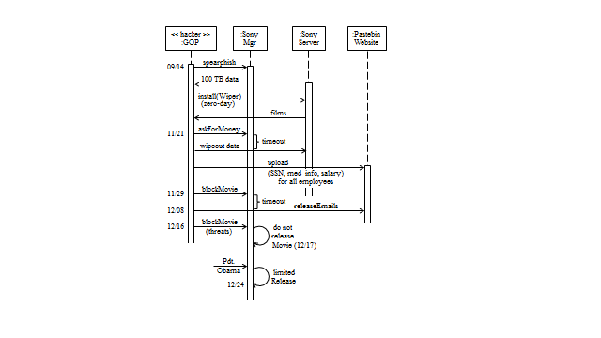
Sony attack sequence

Slide 97
Was this unavoidable?
Use of zero-day attack could not have been protected
No physical control, hackers got into building
Phishing can be stopped by user training
Database servers should have had authentication and authorization systems and have critical fields encrypted
Password files should have been encrypted
Mail servers should have had all emails encrypted
No filter of mail in the firewall (mail to many places from hackers)
No defense in depth, everything collapses after the hackers get in

Slide 98
Evidence of who did it?
The FBI blames N. Korea: use of some IP addresses, modus operandi,…. Since these are not evidence enough they said they have other proofs but would not show them for security reasons.
Taia Global, a cybersecurity firm, analyzed about 1,600 words in emails internal to the group that took responsibility — and determined the primary language used was Russian.
Norse, another company, points to internal hackers.
The truth is the company had no defenses and anybody could have done it.

Slide 99
Hardware malware
So far, mainly software-based attacks have been considered and investigated, while hardware-based attacks have attracted comparatively little interest.
The design and production process of integrated circuits is mostly decentralized due to financial and logistical reasons. Therefore, a high level of trust has to be established between the parties involved in the hardware development lifecycle.
During the complex production chain, malicious attackers can insert non- specified functionality by exploiting untrusted processes and backdoors.
Hidden, non-specified functionality can be introduced into hardware systems. We have a new type of threat, the hardware Trojan.

Slide 101
Security layers

Slide 102
Some common types of attacks
Viruses and worms
Web site defacing and hijacking
Distributed Denial of Service (DDoS)
Illegal database access
Identity-related attacks
Cyberterrorism

Slide 103
Web site defacing and hijacking
Alteration of the web pages of some institution
Visitors may be hijacked to other sites, sometimes impostor sites
Political motivation or lucre
Take advantage of web server weaknesses, e.g., CGI scripts or lack of isolation of pages; also through OS

Slide 104
Dist. Denial of Service
Multiplication of messages towards some site
Requires previously inserted software by perpetrator (slaves), activated together
A site may become inaccessible
Political motivation or vandalism
Uses flaws or features of network protocols and OS flaws

Slide 105
Unauthorized database access
Illegal access to web-connected databases
Stealing of information, e.g., credit card numbers.
Economic reasons
Exploit poor database authorization, implementation, or alternate routes

Slide 106
Identity-related attacks
Assume somebody’s identity to buy goods
Defamation—false information about somebody
May be the result of phishing or from compromising a database
One of the most common attacks
Not always computer based (garbage scavenging is common)

Slide 107
Cyberwar and terrorism
Massive attack to the computer systems of some country or institution or to the Internet itself
Carried out by organized groups or a government
May use all the other attacks or ad hoc attacks

Slide 108
Stuxnet
The Stuxnet worm that disrupted Iran's ability to enrich uranium into bomb-grade nuclear fuel was jointly created by Israel and the U.S., according to the New York Times.
The NYT claimed that Israel's covert nuclear facility at Dimona was used to test the worm's effectiveness on centrifuges like the ones Iran employs at its Natanz complex, which has been plagued by technical problems.
Stuxnet, which first came to light in June 2010 but may have been aimed at Iran as early as mid-2009, has been extensively analyzed by security researchers, most notably by Symantec, and by Ralph Langner of the German firm Langner Communications GmbH.
It was the first example of a cyber-attack doing real damage to a physical system

Slide 109
Highway traffic disruption
Weaknesses in 802.11p vehicular wireless networks could make them targets for terrorists seeking to wreak havoc on the nation's highways, according to a briefing scheduled the Black Hat DC conference of 2012
The technology, commonly used for electronic toll collection, will someday be used for controlling traffic flow and warning drivers of highway dangers – a system that could be exploited if not implemented properly, says Rob Havelt, director of penetration testing at security vendor Trustwave's SpiderLabs, who will co-present a briefing called "Hacking the Fast Lane: Security Issues with 802.11p, DSRC and WAVE".
"It would make killing a lot of people easy," he says of 802.11p systems for traffic control that aren't designed and deployed with an eye toward security. The standard itself is secure, he says, but systems using it are complex and that can lead to insecurity.
For instance, one role of these systems is to warn drivers of potential hazards in the road ahead. If the system is hacked and this information is false, that could lead to drivers reacting in dangerous ways that could cause pileups and traffic jams, he says.

Slide 111
Security-oriented groups
The Trusted Computing Group (TCG) is an industry group that defines standards
for software and hardware products [tcp]. TCG includes over 190 companies.
Their first push is towards hardware-based security, a controversial approach
(see Chapter 3).
The Center for Internet Security (CIS) has developed a set of security
benchmarks for operating systems [cis].
The Forum of Incident Response and Security Teams (FIRST) is an international
consortium of computer incident response and security teams who work together
to handle and prevent incidents [fir].
The Information Technology-Information Sharing and Analysis Center (IT-ISAC) is
an alliance of several companies to share information about product security [iti].

Slide 112
Why UML and patterns?
We need to describe architectures and configurations
Block diagrams are imprecise
Formal descriptions are an overkill, design is not a mathematical discipline
UML is a good compromise; it is intuitive (graphical) and semi-formal
It is also an standard and many developers use it
The most convenient way to describe and design architectures is by the use of patterns

Slide 113
OO and UML
UML is an object-oriented language for specifying, constructing, visualizing, and documenting a software design.
Basically a notation and its corresponding meaning, not a process.
Object Management Group (OMG) standard (www.omg.org)

Slide 114
Patterns
A pattern is a solution to a recurrent problem in a specific context
Idea comes from architecture of buildings (C. Alexander)
Applied initially to software and then extended to other domains
Appeared in 1994 and are slowly being accepted by industry

Slide 115
Value of patterns
A pattern addresses a recurring design problem that appears in some design step and provides a solution for it. Encapsulate experience and knowledge of designers (best practices)
Patterns can be used to document design experience and specific design decisions.
Patterns are concerned with sets of classes, above the abstractions presented by classes or objects, so they provide a larger unit of reuse.
Patterns provide a communication vocabulary for designers.
Good to describe systems and to handle complexity
Patterns can be used to evaluate existing designs. We can see if a product we are considering has features we consider important.

Slide 116
Pattern conferences
Pattern Languages of Programs (PLoP). U of Illinois, USA
EuroPLoP –Irsee, Bavaria, Germany
AsianPLoP—NII and Waseda University, Tokyo, Japan
Latin American PLoP— Brasil/Argentina
GuruPLoP—India
VikingPLoP—Scandinavia or North Europe

Slide 117
Types of patterns
Design patterns—the most common. Describe how to improve code
Architectural patterns—best practices for architectures
Analysis patterns –describe semantic conceptual models
Security patterns—solutions to security problems
Misuse patterns—how an attack is performed
Reliability, safety, and availability patterns
Organizational patterns—how to teach a course, how to organize a company,…

Slide 118
Products and companies
I will mention specific products and companies but this is not an endorsement or recommendation
Products are shown to see what is available and to illustrate features
In fact, some products or companies may not be around anymore and many new ones are appearing

Slide 119
Other textbooks
[And08] R. Anderson, Security Engineering (2nd. Ed.), Wiley, 2008.
[Bis03] M. Bishop, Computer Security: Art and science, Addison-Wesley 2003.
[Gol11] D. Gollmann, Computer security (3rd Ed.), Wiley, 2011.
[Pfl15] C.P.Pfleeger, S.L. Pfleeger, J. Margulies, Security in computing, 5th Ed., Pierson, 2015.

Slide 120
Pattern books
[Bus96] F. Buschmann, R. Meunier, H. Rohnert, P. Sommerland, and M. Stal., Pattern- oriented software architecture, Wiley 1996.
[Fer13] E.B.Fernandez, “Security patterns in practice: Building secure architectures using software patterns”, Wiley Series on Software Design Patterns, 2013.
[Gam94] E. Gamma, R. Helm, R. Johnson, J. Vlissides. Design Patterns: Elements of Reusable Object-Oriented Software, Addison-Wesley, Boston, Mass., 1994
[Sch06] M. Schumacher, E. B.Fernandez, D. Hybertson, F. Buschmann, and P. Sommerlad, Security Patterns: Integrating security and systems engineering", Wiley Series on Software Design Patterns, 2006.

